Slide 1
HTML – CSS3
Instructor: tal yaron
Email: tal.yaron@gmail.com
Phone: 052-607-9419

Slide 2
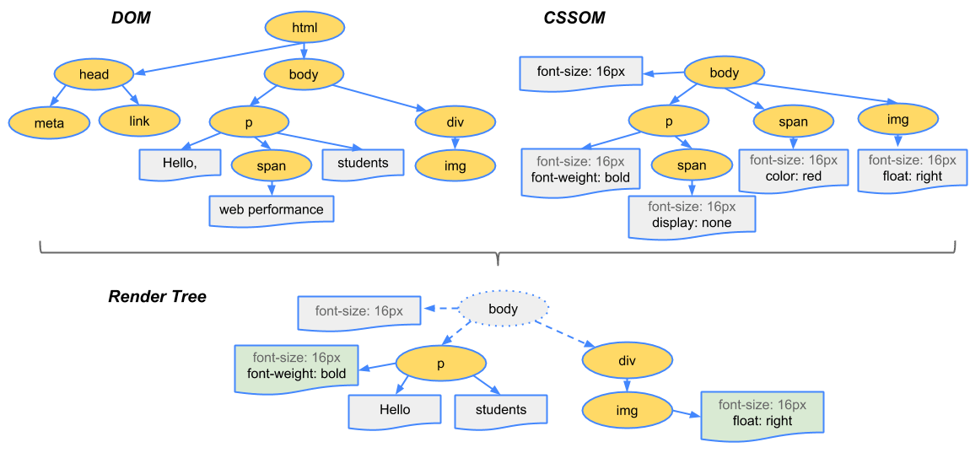
HTML CSS3
CSS = Cascading Style Sheets
CSS3 = Level of development (3)
CSS4 (flexbox)
https://developers.google.com/web/fundamentals/performance/critical-rendering-path/render-tree-construction

Slide 3
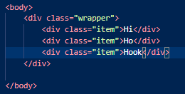
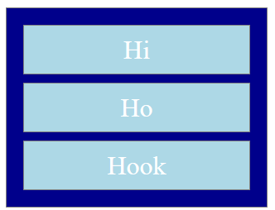
Nesting

Slide 4
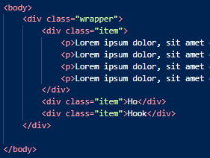
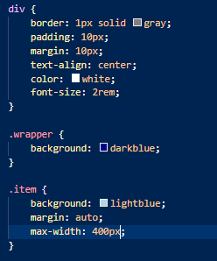
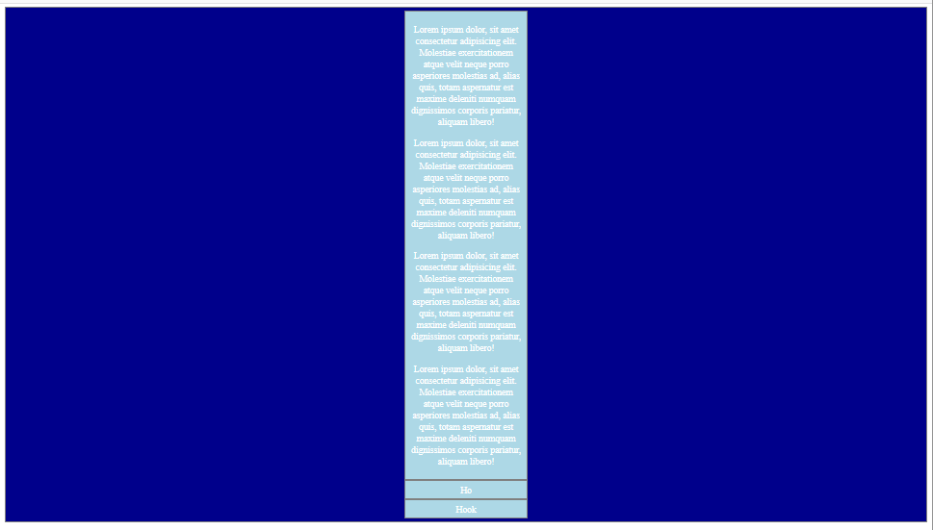
Nesting
With nesting we can wrap all sub DOM elements

Slide 5
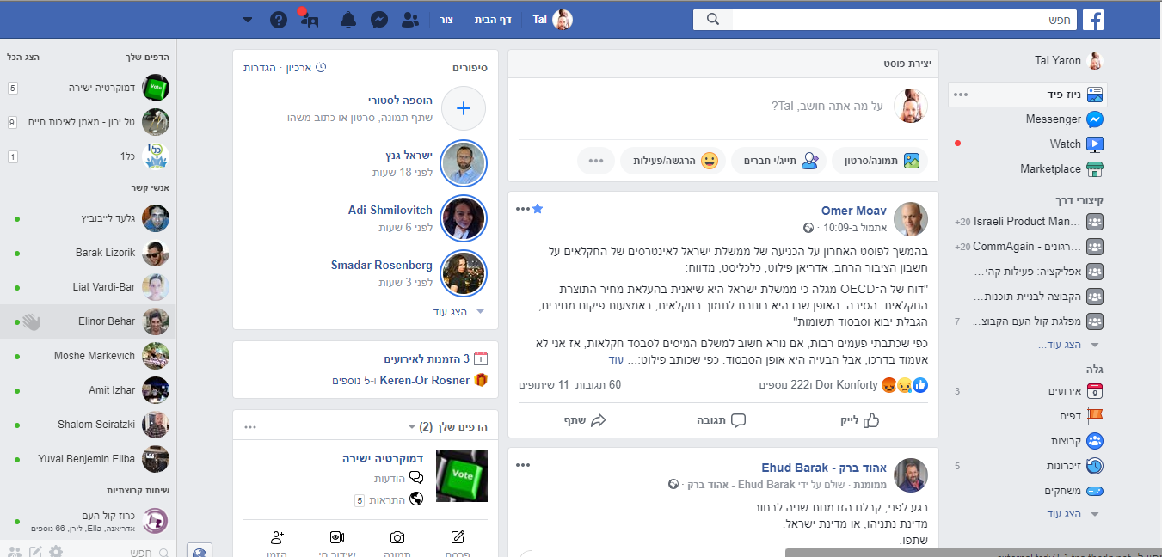
Nesting
Can you explain how this page is nested?

Slide 6

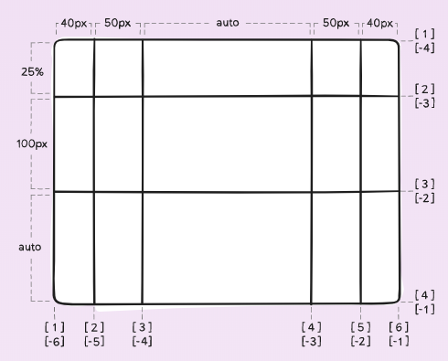
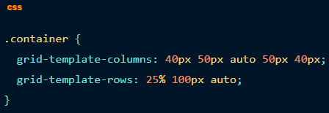
CSS – Grid (just starting)
https://css-tricks.com/snippets/css/complete-guide-grid/

Slide 7
CSS - Flexbox
https://caniuse.com/#search=flex
https://css-tricks.com/snippets/css/a-guide-to-flexbox/
Container
Display: flex
item
item

Slide 8
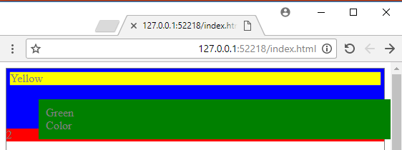
CSS - positions
\02 - CSS3\index.html

Slide 9
CSS - positions
Static – default
Fixed – fixed on window
Relative – relative to the position of the parent div (div is still taking its place)
Absolute - the element is positioned relative to its first absolute parent, and don’t take space
Sticky – cool new feature (https://www.w3schools.com/cssref/tryit.asp?filename=trycss_position_sticky)

Slide 10
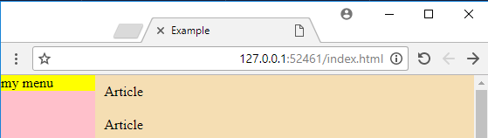
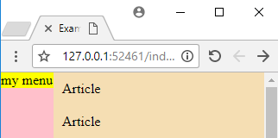
CSS – positions (workout)

Slide 11
CSS - Tables
<table>
<tr>
<th>
<tr>
<td>
<tr>
<tr>
<tr>
<tr>
https://www.w3schools.com/html/html_tables.asp

Slide 12
CSS – positions (float)
Float (right, left)

